Slide 1

Challenges in alchemical free energy calculations
Stefano Bosisio
Julien Michel Group
15/06/2018
ScotCHEM 2018 Symposium

Slide 2
What are alchemical free energy calculations?
Challenges in alchemical free energy: Reproducibility Lipophilicity estimations Host-guest binding affinities
Conclusions

Slide 3
What are alchemical free energy calculations?
Challenges in alchemical free energy: Reproducibility Lipophilicity estimations Host-guest binding affinities
Conclusions

Slide 4
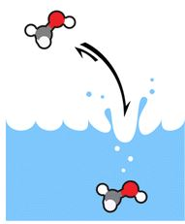
What are alchemical free energy calculations?
Rigorous and efficient method to compute:
Solvation free energy:
hydration free energy of molecule A
Mobley et al. J. Phys. Chem. B.,
2014, 6438-6446.
Notes:
Fennell, Christopher J., Karisa L. Wymer, and David L. Mobley. "A fixed-charge model for alcohol polarization in the condensed phase, and its role in small molecule hydration." The Journal of Physical Chemistry B 118.24 (2014): 6438-6446.

Slide 5
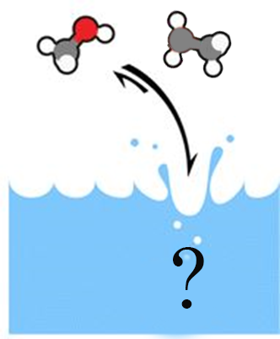

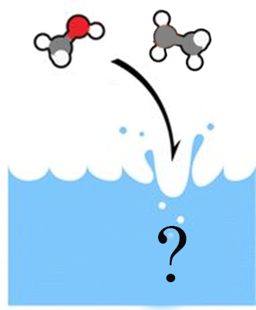
What are alchemical free energy calculations?
Rigorous and efficient method to compute:
Solvation free energy:
Relative free energy:
Is A more likely to be
solvated than B?
Notes:
Maybe here; you may be apharmaceutical company or a good chemists and want to know hwich of your ligand is more likely to bind to a particular receptor. in particular, you may want to know a relative free energy, which is the more likey to bind among ligands or absolute free energy of binding, so how likey is the ligand to bind to the receptor. These information can be retrieved with a fvery powerful method, ie alchemical free energy calculatoins.
Say that it’s since the 50s people are developing these apporaches
Now, since it is impossibile to simulate a direct transfer of a molecule from infinita apart to a recepto, then in the cavity and then released again, we adopt a thermodynamic cycle
in relative transformation th emolecule A is transformed into molecule B, which we want to know the free enregy, passing through alchemical intermediates where we are coupling the physical parameters of A into lambda for B. The same for bound phase and it can be proved that the differnece is relative of absolute

Slide 6
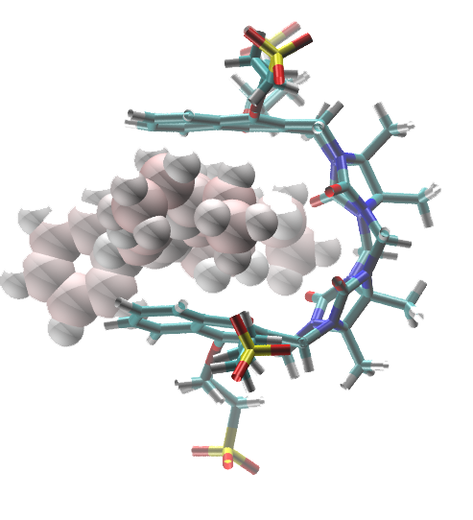
What are alchemical free energy calculations?
Rigorous and efficient method to compute:
Solvation free energy:
Binding affinities:
Relative free energy:
Notes:
Maybe here; you may be apharmaceutical company or a good chemists and want to know hwich of your ligand is more likely to bind to a particular receptor. in particular, you may want to know a relative free energy, which is the more likey to bind among ligands or absolute free energy of binding, so how likey is the ligand to bind to the receptor. These information can be retrieved with a fvery powerful method, ie alchemical free energy calculatoins.
Say that it’s since the 50s people are developing these apporaches
Now, since it is impossibile to simulate a direct transfer of a molecule from infinita apart to a recepto, then in the cavity and then released again, we adopt a thermodynamic cycle
in relative transformation th emolecule A is transformed into molecule B, which we want to know the free enregy, passing through alchemical intermediates where we are coupling the physical parameters of A into lambda for B. The same for bound phase and it can be proved that the differnece is relative of absolute

Slide 7
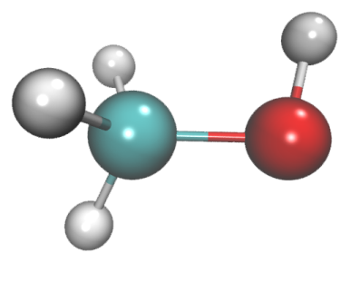
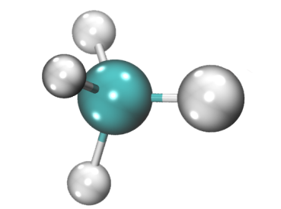



Tackling with configuration integrals
Relative free energy:
$$ΔG_{A}$$
$$ΔG_{B}$$
$$ΔG_{hyd}=ΔG_{B}−ΔG_{A}$$
Notes:
All the perturbations can be implemented as thermodynamic cycles
in this case we can imagine to transform molecule a into molecule b and obatining the free energy of binding – the relative f.binding between A and B to know which is the most likely bindier
So far so good but

Slide 8
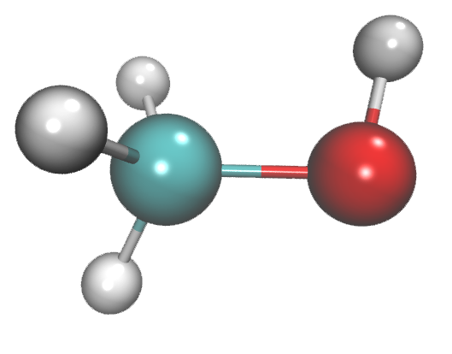
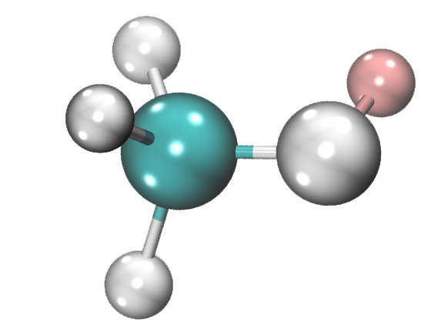
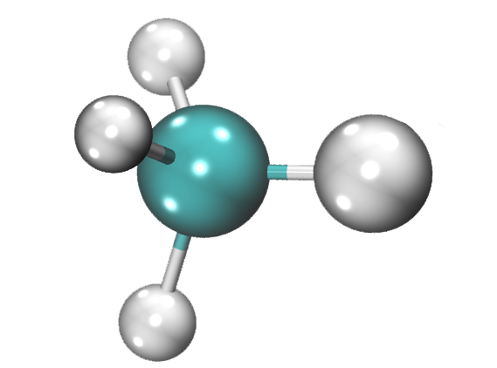
Alchemical free energy calculations and thermodynamic cycle
Relative free energy:
$$ΔG_{A}$$
$$ΔG_{B}$$
$$ΔG_{hyd}=ΔG_{B}−ΔG_{A}$$
λ
0.0 0.2 0.4 0.6 0.8 1.0
Notes:
All the perturbations can be implemented as thermodynamic cycles
in this case we can imagine to transform molecule a into molecule b and obatining the free energy of binding – the relative f.binding between A and B to know which is the most likely bindier
So far so good but

Slide 9




Alchemical free energy calculations and thermodynamic cycle
Relative free energy:
$$ΔG_{A}$$
$$ΔG_{B}$$
$$ΔG_{hyd}=ΔG_{B}−ΔG_{A}$$
λ
0.0 0.2 0.4 0.6 0.8 1.0
Notes:
All the perturbations can be implemented as thermodynamic cycles
in this case we can imagine to transform molecule a into molecule b and obatining the free energy of binding – the relative f.binding between A and B to know which is the most likely bindier
So far so good but

Slide 10
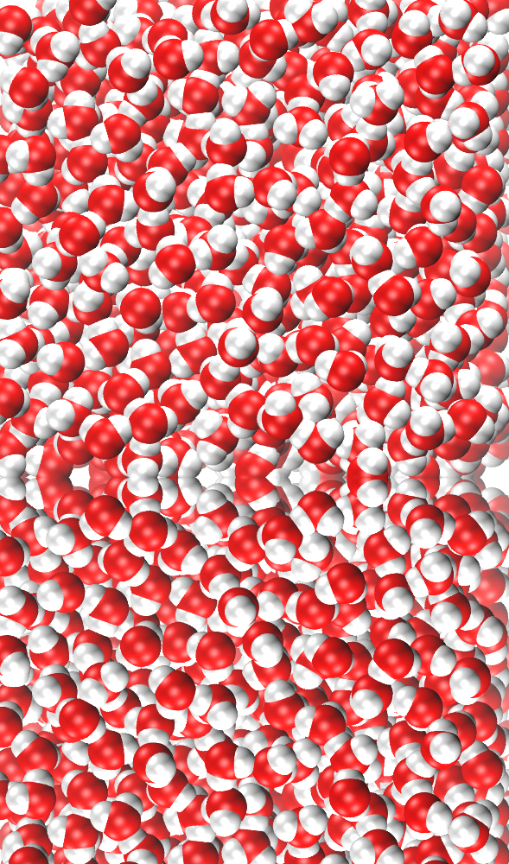
Alchemical free energy calculations and thermodynamic cycle
Relative free energy:
$$ΔG_{A}$$
$$ΔG_{B}$$
$$ΔG_{hyd}=ΔG_{B}−ΔG_{A}$$
λ
0.0 0.2 0.4 0.6 0.8 1.0
Notes:
All the perturbations can be implemented as thermodynamic cycles
in this case we can imagine to transform molecule a into molecule b and obatining the free energy of binding – the relative f.binding between A and B to know which is the most likely bindier
So far so good but

Slide 11



Alchemical free energy calculations and thermodynamic cycle
Relative free energy:
$$ΔG_{A}$$
$$ΔG_{1}$$
$$ΔG_{2}$$
$$ΔG_{B}$$
$ΔG_{hyd}=ΔG_{B}−ΔG_{A}$ $=ΔG_{2}−ΔG_{1}$
Notes:
All the perturbations can be implemented as thermodynamic cycles
in this case we can imagine to transform molecule a into molecule b and obatining the free energy of binding – the relative f.binding between A and B to know which is the most likely bindier
So far so good but

Slide 12
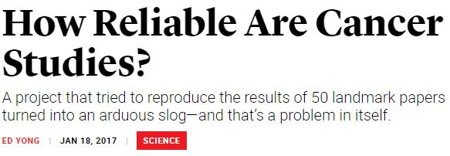
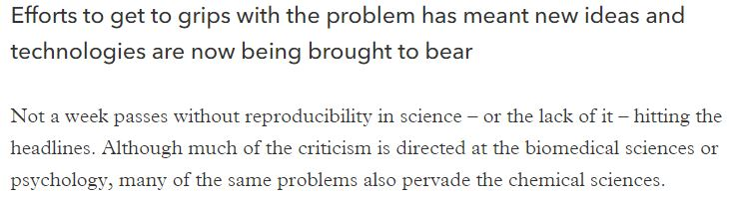
The problem of reproducibility in chemistry
Notes:
what can be really thee problem are other factors, which are extremely important andv have their eeffects, namely finite size artefacts and reproducibiltiy
oterhwise how can I reach a high throughtput ?
Namely these challanges deal mainly with
= Finite size artefacts, which affect free energy calculations up to 20 kcal/mol. This kind of error is given from the way we implement our simulations thus how we treat the electrostatic intearctions and periodic boundary ocnditions
= Secondly there is a lack of reproducibility amondg different codes. Given the same input files and running free enrgy calculations between my code and your wwill give different results
All these problems must be addressed to enable robust free energ yprotocols for routine simulations

Slide 13





Reproducibility is a CompChem problem too
Same input files
Same analysis protocol
ΔG = 3.0±0.5 kcal mol⁻¹
ΔG = 5.0±0.2 kcal mol⁻¹
Notes:
Lack of reproducibility among different codes
Same input files
Same analysis protocol
Different implementations

Slide 14
What are alchemical free energy calculations?
Challenges in alchemical free energy: Reproducibility Lipophilicity estimations Host-guest binding affinities
Conclusions

Slide 15
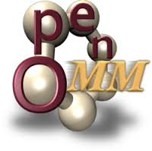
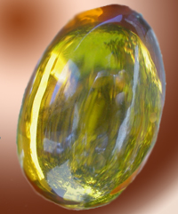
Are alchemical free energy calculations reproducible?
Benoit Roux (UCHI)
David Mobley group (UCI)
Same input files
Same analysis protocol
Julien Michel group
(UoE)
Hannes Loeffler (STFC)
SOMD
Amber
Notes:
Lack of reproducibility among different codes
Same input files
Same analysis protocol
Different implementations

Slide 16
Study on relative free energy of hydration
CH₄
C₂H₆
SOMD
Amber
Notes:
Add arrows here?

Slide 17
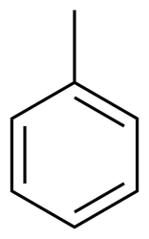
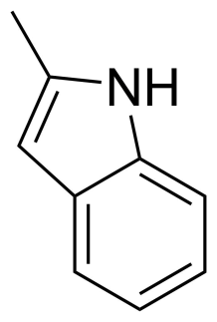
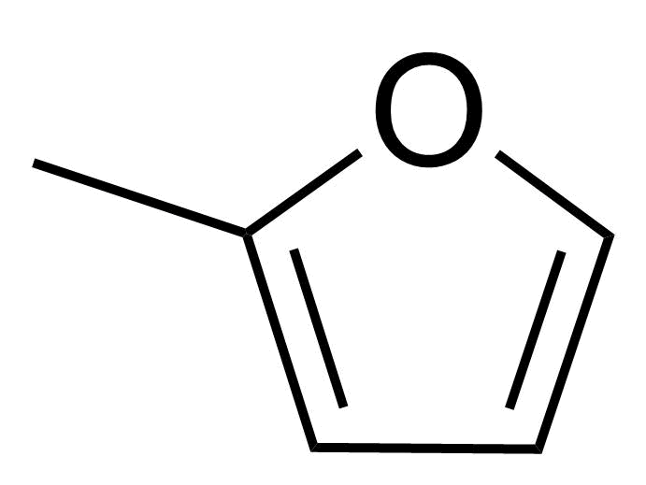
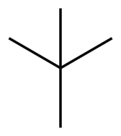
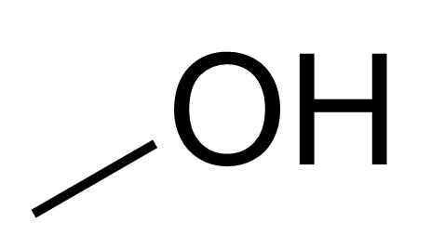
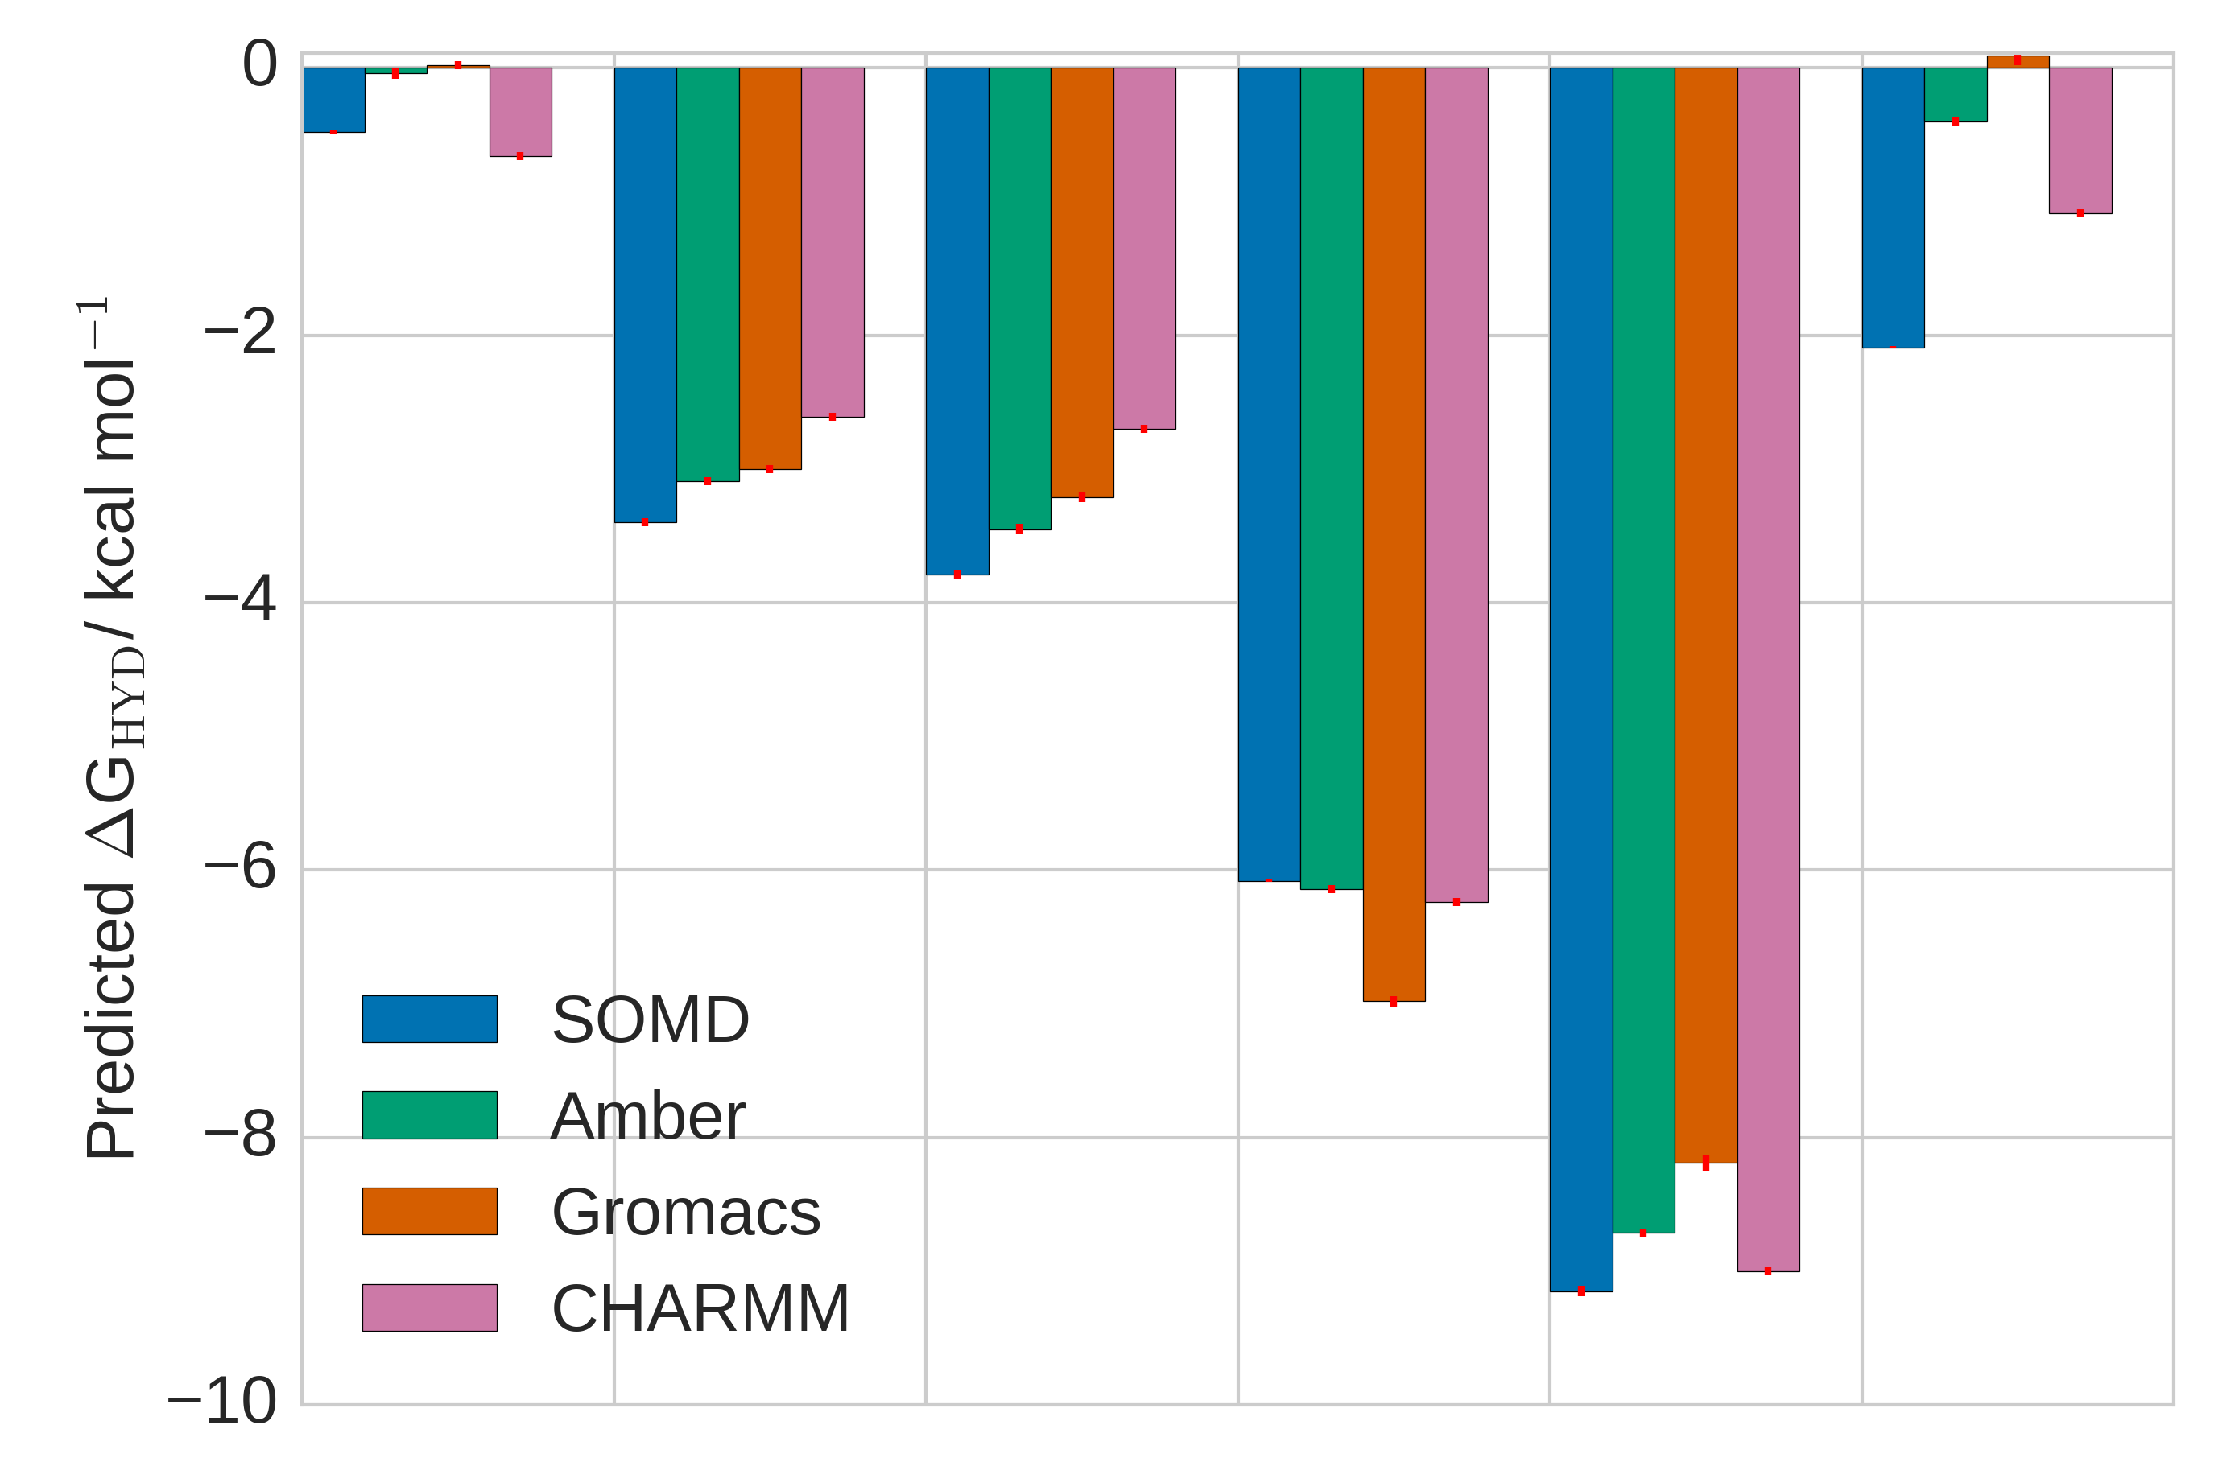
Inconsistencies in relative free energy of hydration
C₂H₆
MUE
SOMD-Gromacs: 1.00 kcal mol⁻¹
SOMD-Amber:
0.83 kcal mol⁻¹
SOMD-CHARMM:
0.56 kcal mol⁻¹
Notes:
Add CHARMM

Slide 18
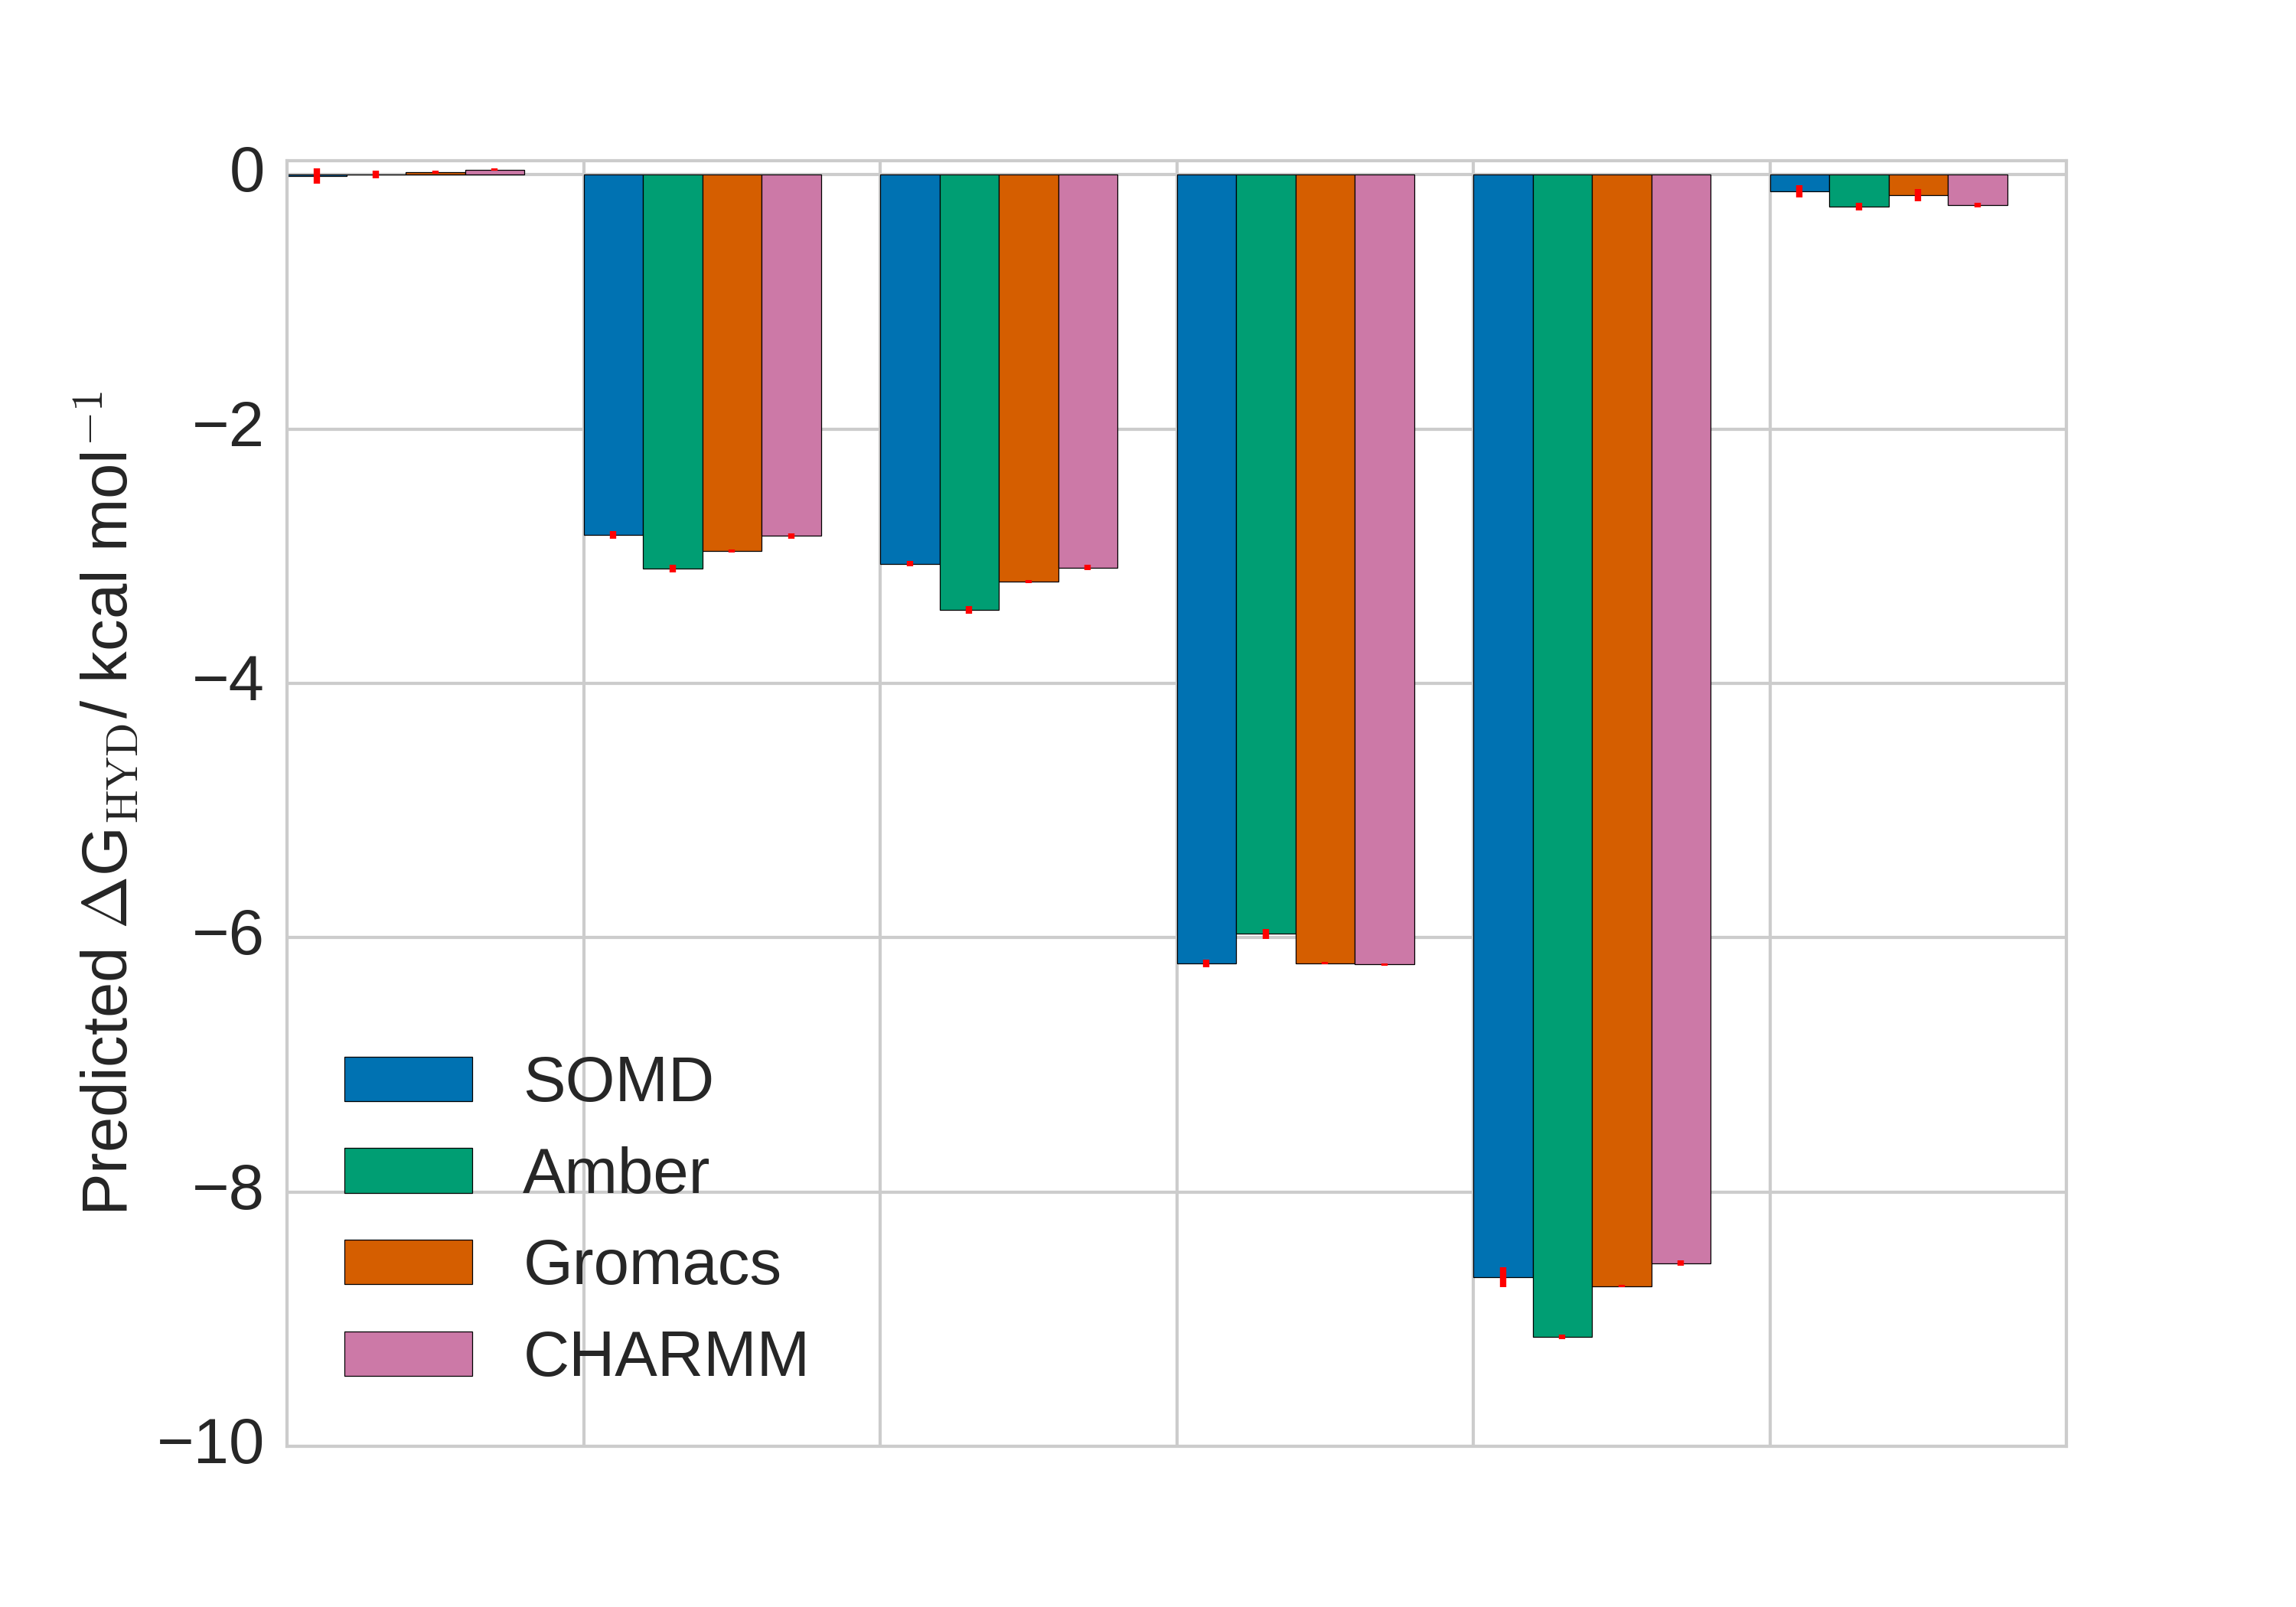
Code specific issues do influence the reproducibility
  Careful analyses led us to devise a new constraint in relative free energy calculations, maintaining 2 fs timestep
C₂H₆
MUE
SOMD-Gromacs: 0.11 kcal mol⁻¹
SOMD-Amber:
0.23 kcal mol⁻¹
SOMD-CHARMM:
0.15 kcal mol⁻¹
MUE
SOMD-Gromacs: 1.00 kcal mol⁻¹
SOMD-Amber:
0.83 kcal mol⁻¹
SOMD-CHARMM:
0.56 kcal mol⁻¹

Slide 19
CompChem reproducibility: lesson learned
C₂H₆
MUE
SOMD-Gromacs: 0.11 kcal mol⁻¹
SOMD-Amber:
0.23 kcal mol⁻¹
SOMD-CHARMM:
0.15 kcal mol⁻¹
What did we learn?
Implementation details mainly influence the reproducibility
Impossibility of having a universal protocol of simulation
Limit in reproducibility up to 0.2 kcal mol⁻¹
New codes can be tested with this dataset

Slide 20
What are alchemical free energy calculations?
Challenges in alchemical free energy: Reproducibility Lipophilicity estimations Host-guest binding affinities
Conclusions

Slide 21
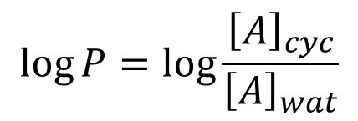
A further step: free energy predictions for log P estimations
$$\log{P}=\log{\frac{{\left[A\right]}_{cyc}}{{\left[A\right]}_{wat}}}$$
Why log P is so important?
Indication on distribution and absorption of a drug in a body
Evaluation for possible drug candidates
Cyclohexane
Water
Notes:
What is logD? EXPLAIN

Slide 22

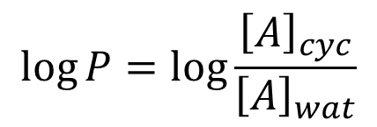
Can we predict log P with alchemical calculations?
$$\log{P}=\log{\frac{{\left[A\right]}_{cyc}}{{\left[A\right]}_{wat}}}$$
University of St. Andrews
Cyclohexane
Water
Notes:
What is logD? EXPLAIN

Slide 23
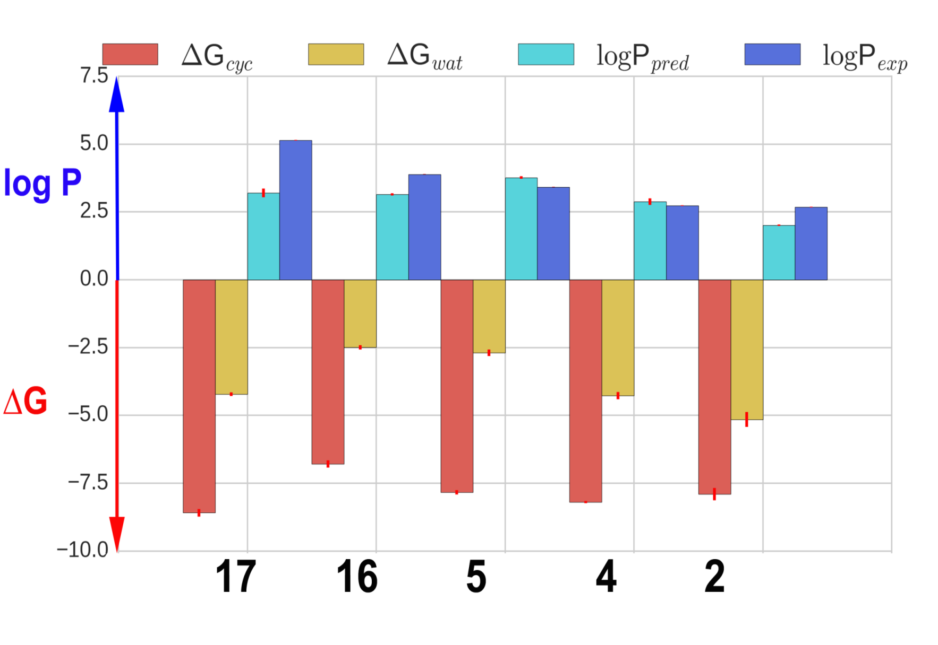
log P estimations are in line with experimental data
Kendall τ 0.50 +/- 0.10
MUE 0.77 +/- 0.01
What did we learn?
  A good approximation of the organic phase can give reasonable results
  Alchemical free energy calculations have potential for lipophilicity measurements of small neutral molecules
  Extension to tautomers and protonated species
Notes:
What is logD? EXPLAIN

Slide 24
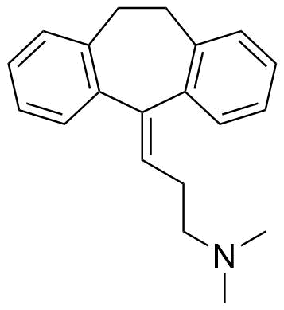
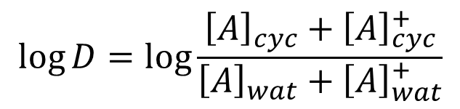
A more complicated step: log D predictions
$$\log{D}=\log{\frac{{\left[A\right]}_{cyc}+{\left[A\right]}_{cyc}^{+}}{{\left[A\right]}_{wat}+{\left[A\right]}_{wat}^{+}}}$$
Why log D is so important?
Indication on distribution and absorption of a drug in a body
Evaluation for possible drug candidates
Cyclohexane
Water
Notes:
What is logD? EXPLAIN

Slide 25


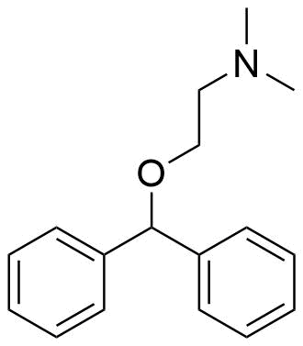
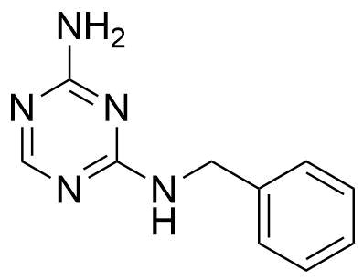
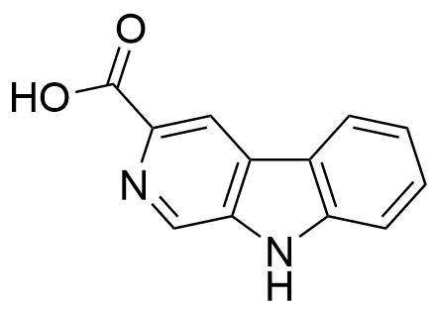
SAMPL5 log D prediction challange
Predict log D values for 53 drug-like molecules:
Statistical Assessment of the Modeling of Proteins and Ligands
I measured some logD can you predict them?
Notes:
What is logD? EXPLAIN

Slide 26
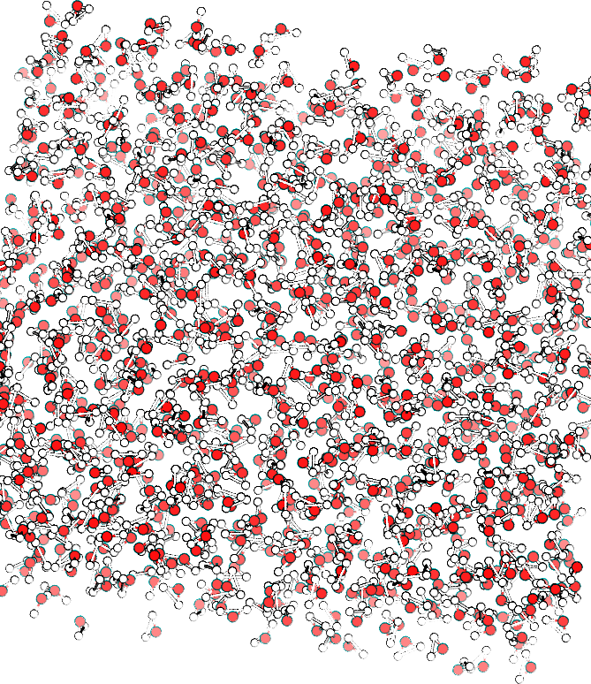
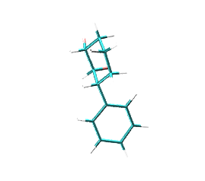
Finite size artefacts influence free energy calculations
Periodic boundary
conditions
Cutoff dispersion
interactions
Effective
electrostatics interactions
Notes:
Lead optmiziation??
Start wirth repro
later : Oh my god there s finite size artefacts! :o

Slide 27
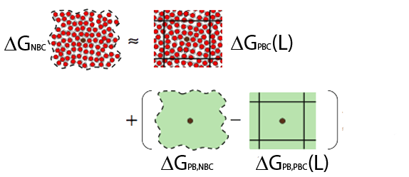
Kastenholz M. A., Hunenberger P. H, J. Chem. Phys,124, 22, 2006
Rocklin et al., J. Chem. Phys., 139, 18, 20143
Reif M., Oostenbrink C., J. Comput. Chem., 38, 3, 2014
Correcting finite size artefacts in log D calculations
We corrected simulation results for:
Missing dispersion interactions
Missing electrostatic interactions
Protonation changes between cyclohexane and water phases
Notes:
Remember cont electro

Slide 28
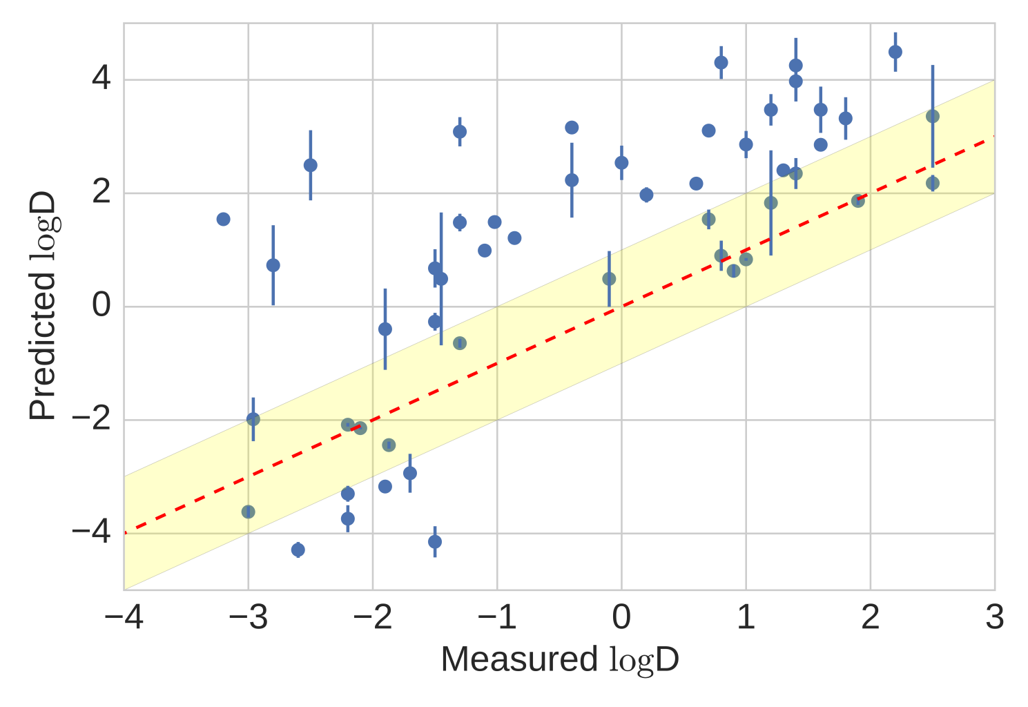
Our best submission for log D estimation
R² : 0.40 ± 0.05
MUE: 1.97 ± 0.08 log D
What did we learn?
  pkA correction significantly improved results
  Correction for missing electrostatic interactions important to improve hydration free energy estimates for ionic species but not log D
Notes:
Give a r2 +// and mue +/-Bosisio, Stefano, Antonia SJS Mey, and Julien Michel. "Blinded predictions of distribution coefficients in the SAMPL5 challenge." Journal of Computer-Aided Molecular Design 30.11 (2016): 1101-1114.
Bosisio S. Mey ASJS, Michel J., J. Comput. Aided. Mol. Des., 2016, 1101-1114

Slide 29
What are alchemical free energy calculations?
Challenges in alchemical free energy: Reproducibility Lipophilicity estimations Host-guest binding affinities
Conclusions

Slide 30
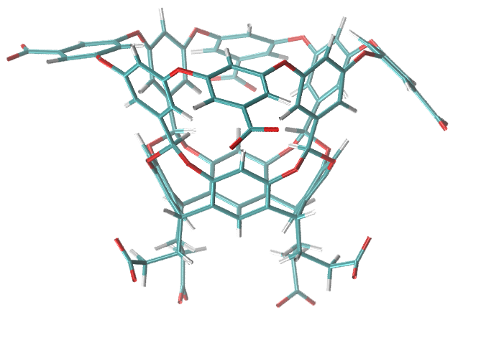
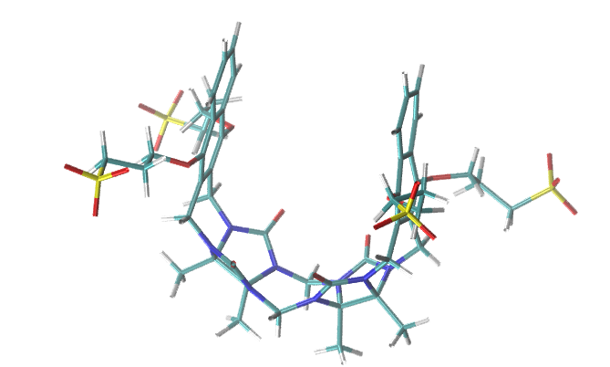
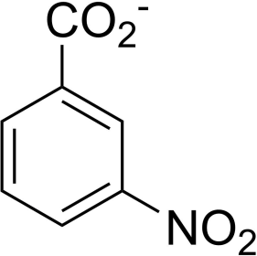
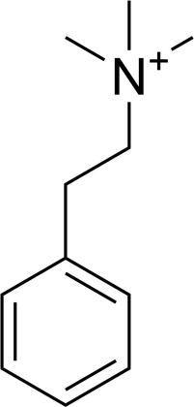
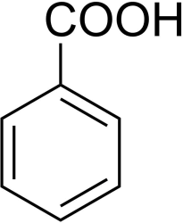
SAMPL5 binding affinities challenge
Statistical Assessment of the Modeling of Proteins and Ligands
I measured some free energy of binding
can you predict them?
OA/TEMOA
CB7 Clip
Notes:
Thus, to assess the state of art and help the free energy community blinded free energy are a powerful tool . IN this way is possible to draw a comparison between barious methods, alchemical free energy calculation for example or qunatum mechanical methods. This is a good way to understand where we are among the community with our techniques
We took part in the SAMPL in the 2015, whose aim is to give an assess and comparison of various free enrgy methods, ranging from qnatum mechanics to molecular mechanics, for two different tasks
One was to compute the binding affinities among these families of host and guests

Slide 31


Are alchemical calculations ready for molecular design?
Wow!
Stefano, I found a ΔG°_{bind} =
-3.0 +/- 0.5 kcal mol⁻¹
Wow!
I spent the whole night debugging and I have
ΔG_{bind} =
-8.0 +/- 0.5 kcal mol⁻¹
Notes:
Here add: This brings alchemical free energy calculations to be hard to be translated into a robust engineering tool for routine applications

Slide 32
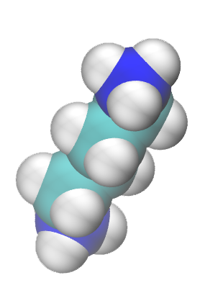
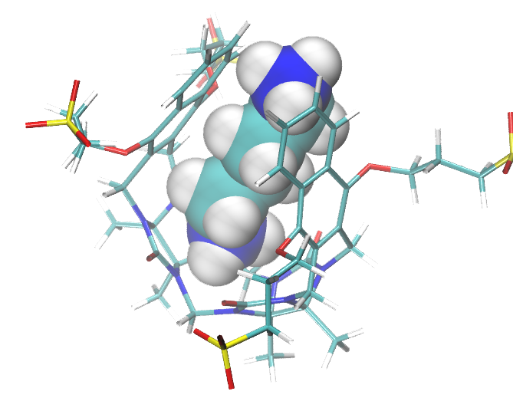

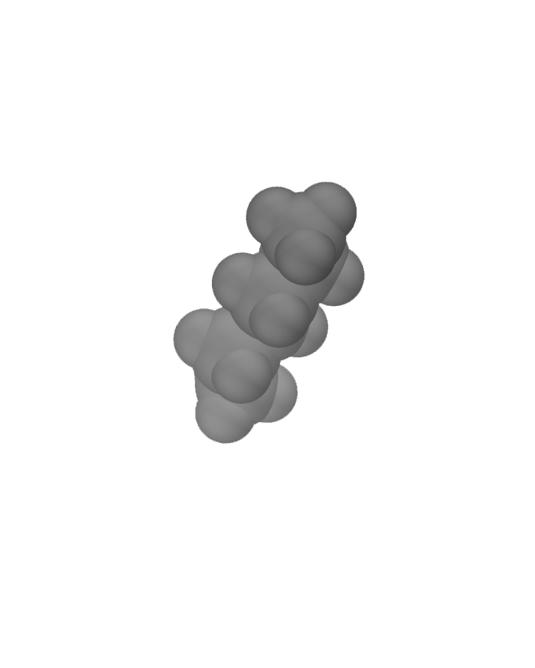
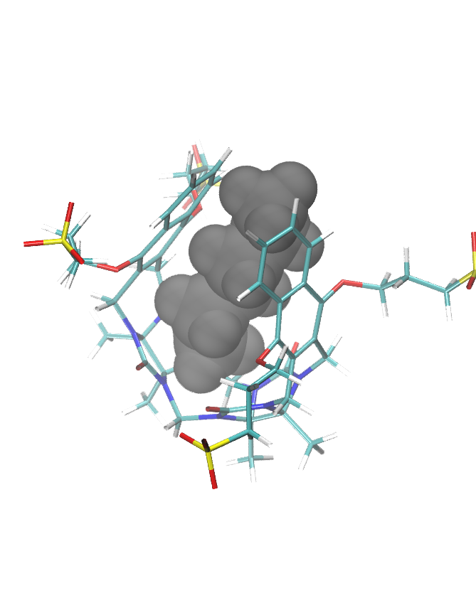



SAMPL5: Assessing the standard state correction
H + G⇌ HG
$$ΔG_{bind}$$
1 M
$$ΔG_{off1}$$
$$ΔG_{off2}$$
Standard state:
define a computational vial
Notes:
Here you can say: experimentally you have a vial with a definite volume, you’re taking your measruements to
while experimentally we don’t have it
this can be translated and computed a sthe volume exlpolored by the molecule in the cavity

Slide 33
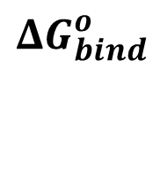


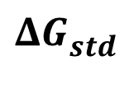

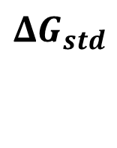
SAMPL5: Assessing the standard state correction
H + G⇌ HG
$$ΔG_{bind}^{o}$$
1 M
$$ΔG_{off1}$$
$$ΔG_{off2}$$
Standard state:
define a computational vial
$$ΔG_{std}$$
$$ΔG_{bind}^{o}=ΔG_{off1} −ΔG_{off2}+ΔG_{std}$$
Notes:
Here you can say: experimentally you have a vial with a definite volume, you’re taking your measruements to
while experimentally we don’t have it
this can be translated and computed a sthe volume exlpolored by the molecule in the cavity

Slide 34
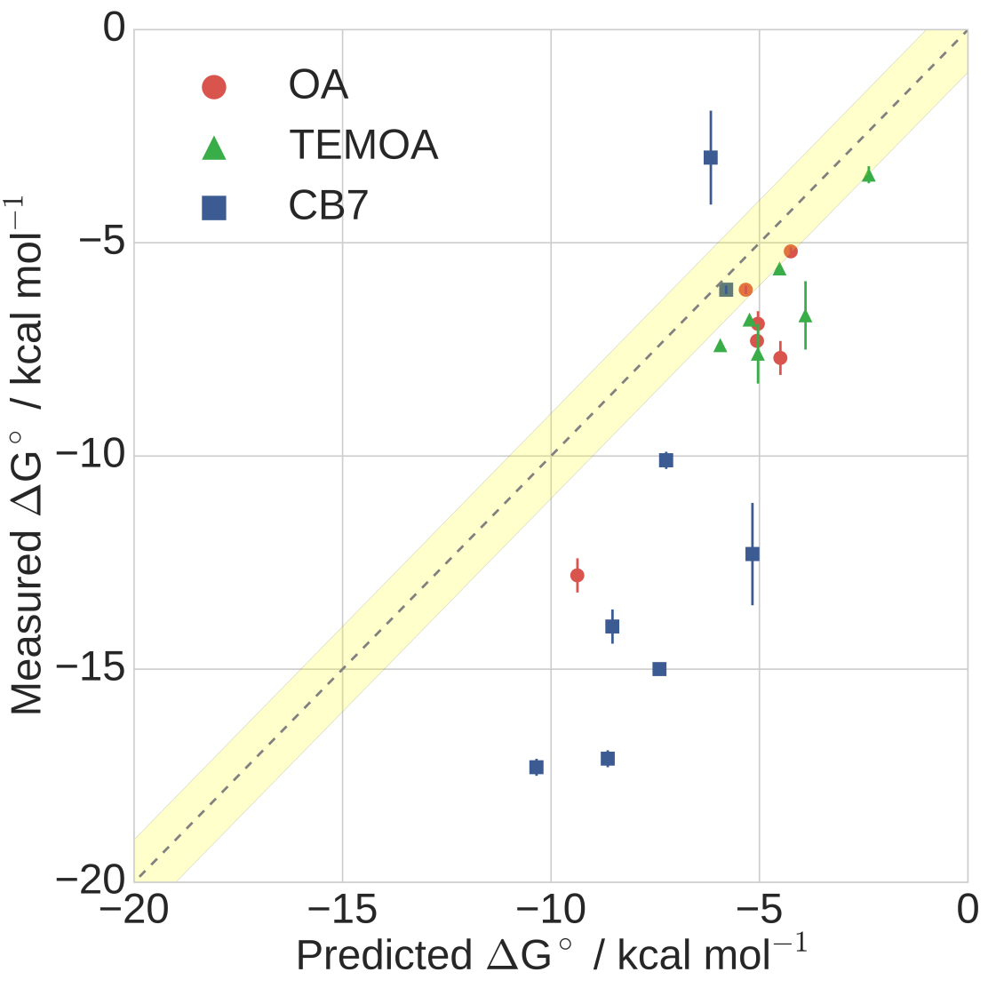

SAMPL5: Standard state corrections improve estimations
R² : 0.69 ± 0.05
tau: 0.56 ± 0.05
MUE: 3.36 ± 0.16 kcal mol⁻¹
What did we learn?
  Standard state corrections improve results
  A good protocol, but room to improve systematic errors
  Among the top ranked in SAMPL5 submissions
Notes:
Remove the standard fe to a binding free energy
add a label to CB8
add statistics

Slide 35
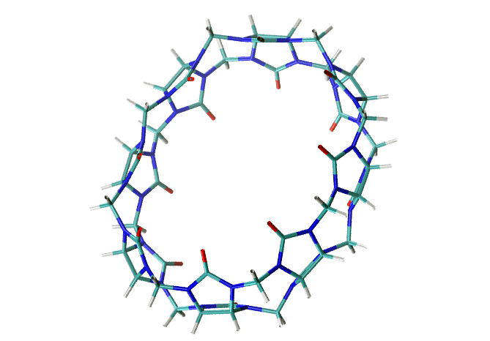
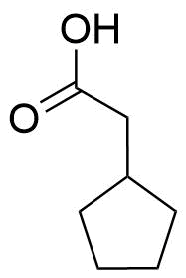
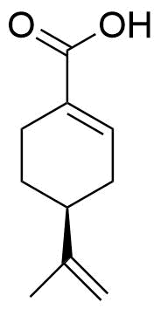
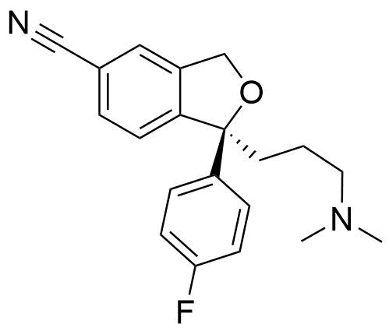
SAMPL6: Can we do even better?
Hosts and guests have a net charge at experimental pH
The molecular parameters ( bond, angle, dihedrals, charges, van der Waals) could affect predictions
Presence of a Na₃PO₄ buffer in experimental setup
OA/TEMOA
CB8
Notes:
Remove the standard fe to a binding free energy
add a label to CB8
add statistics

Slide 36



SAMPL6: Can we do even better?
$$ΔG_{exp}^{o}=αΔG_{sampl5}+β$$
$$ΔG_{bind}^{o}= \frac{ΔG_{bind}−β}{α}$$
OA/TEMOA
CB8
Notes:
The new free energy DG_std_bind = DG_sampl5 + beta/alpha
DG_exp = alpha*DG_sampl5 + beta

Slide 37


SAMPL6: systematic offset correction gives excellent results
R² : 0.66 ± 0.03
tau: 0.50 ± 0.03
MUE: 1.47 ± 0.10 kcal mol⁻¹
What did we learn?
  Linear regression could help for systematic effects
  Excellent results for rigid host-guest systems
  Room for improvement and considerations about buffer

Slide 38
What are alchemical free energy calculations?
Challenges in alchemical free energy: Reproducibility Lipophilicity estimations Host-guest binding affinities
Conclusions

Slide 39


Conclusions
Implementation details can hinder reproducibility of free energies
Detailed comparisons between codes help produce more robust and efficient protocols
Lipophilicity measurements:
Encouraging log P predictions, necessity to extend this protocol for log D calculations.
Host-guest binding affinities:
Good to know from the past, but buffer and
net charges treatment is demanding
Alchemical free energy calculations show potential for high-throughput workflow:
It pays off to think outside of the (periodic) box ! (cutoffs in dispersion and electrostatic energies, standard state, pkA corrections)
Notes:
So to conclude
we saw and learned that the implementation details can hinder the reproducibility of results in free energy calculations , gaining a new dataset and protocol for enhanche simulatoins
that from SAMPL5 host guest binding free energy are very competitive but it’s time to add new corrections like electrostatics and the dist c have problem in ff description
so: alchemical free energy calcualtion are a potential for molecular design, but definitely it pays off to think outside the box!

Slide 40


A big thank you to the Julien Michel group:
Dr Julien Michel Dr Charis Georgiou
Dr Antonia Mey Pattama Wapeesittipan
Dr Jordi Juárez Jiménez Joan Clark Nicolas
Dr Alessio De Simone Harris Ioannidis
Dr Arun Gupta Lisa Patrick
Dr Cesar Mendoza Martinez Michail Papadourakis
Dr Salome Llabres Marie Bluntzer
Reproducibility project:
Dr Hannes Loeffler
Guilherme Duarte Ramos
Dr Donghyuk Suh
Dr Benoit Roux
Dr David Mobley
Lipophilicity study:
Dr David O'Hagan
Andrea Rodil
Notes:
Hannes H. Loeffler Stefano Bosisio Guilherme Duarte Ramos Matos Donghyuk Suh Benoît Roux David L. Mobley Julien Michel

Slide 41
Thank you for your attention

Slide 42

Standard state correction: Experimental free energy
H + G⇌ HG
The standard free energy of binding can be computed
from the equilibrium constant :
Now, what we are doing is:
$$ΔG_{bind}^{0}=−k_{B}T\ln{\frac{Z_{HG}}{Z_{G}Z_{H}}\frac{V}{V^{0}}}$$
1 M = 1660 Å³ mol⁻¹
Notes:
Here you can say: experimentally you have a vial with a definite volume, you’re taking your measruements to
while experimentally we don’t have it
this can be translated and computed a sthe volume exlpolored by the molecule in the cavity

Slide 43




Standard state correction: decomposition of the alchemy
H + G⇌ HG
$$ΔG_{bind}^{o}$$
$$ΔG_{off1}$$
$$ΔG_{off2}$$
$$ΔG_{std}$$
Notes:
Here you can say: experimentally you have a vial with a definite volume, you’re taking your measruements to
while experimentally we don’t have it
this can be translated and computed a sthe volume exlpolored by the molecule in the cavity

Slide 44


Standard state correction: logarithm in action
H + G⇌ HG
Let's develop the contribution for every free energy change
Collecting all the terms and applying logarithmic rules:
$$ΔG_{bind}=−k_{B}T\ln{\frac{Z_{G}^{q=0} Z_{G}^{vdW=0}}{Z_{G}Z_{G}^{q=0}}}+k_{BT}\ln{\frac{Z_{HG}^{q=0} Z_{HG}^{vdW=0}}{Z_{HG}Z_{HG}^{q=0}}}$$
$ΔG_{bind}=−k_{B}T\ln{\frac{Z_{G}^{q=0} Z_{G}^{vdW=0}Z_{HG}Z_{HG}^{q=0}}{Z_{G}Z_{G}^{q=0}Z_{HG}^{q=0} Z_{HG}^{vdW=0}}}=−k_{B}T ln\frac{Z_{HG}}{Z_{H}Z_{G}}$
Notes:
Here you can say: experimentally you have a vial with a definite volume, you’re taking your measruements to
while experimentally we don’t have it
this can be translated and computed a sthe volume exlpolored by the molecule in the cavity

Slide 45


Standard state correction: the reference volume is missing
H + G⇌ HG
As you can see we are missing the reference volume:
Experimental:
Computational:
$$ΔG_{bind}^{0}=−k_{B}T\ln{\frac{Z_{HG}}{Z_{G}Z_{H}}\frac{V}{V^{0}}}$$
$ΔG_{bind}=−k_{B}T ln\frac{Z_{HG}}{Z_{H}Z_{G}}$
Notes:
Here you can say: experimentally you have a vial with a definite volume, you’re taking your measruements to
while experimentally we don’t have it
this can be translated and computed a sthe volume exlpolored by the molecule in the cavity

Slide 46
Standard state correction: restraint
H + G⇌ HG
Application of a restraint to prevent the
guest from drifting off the cavity
In this last step the ligand is «non interacting», since charges are off and vdW terms are turning off.
Thus, to prevent the ligand from drifting away from teh host cavity, which could lead to a slow the convergence, a restraint is applied during the whole simulation between the guest and the host:
Notes:
Here you can say: experimentally you have a vial with a definite volume, you’re taking your measruements to
while experimentally we don’t have it
this can be translated and computed a sthe volume exlpolored by the molecule in the cavity

Slide 47

Standard state correction: restraint
In this last step the ligand is «non interacting», since charges are off and vdW terms are turning off.
Thus, to prevent the ligand from drifting away from teh host cavity, which could lead to a slow the convergence, a restraint is applied during the whole simulation between the guest and the host:
H + G^{ideal} = H ∞ G^{ideal}
  Ligand in an thermodynamically
  ideal state – since it is not interacting
Ideal ligand constrained to the protein
Writing this reaction in terms of equilibrium constant
$$−k_{B}T\ln{\frac{Z_{H∞G^{ideal}}}{Z_{G^{ideal}}Z_{H}}=−k_{B}T\ln{\frac{Z_{H}Z_{∞G^{ideal}}}{Z_{H}Z_{G^{ideal}}^{} }=−k_{B}Tln \frac{Z_{∞G^{ideal}}}{Z_{G^{ideal}}^{}}}}$$
Notes:
Here you can say: experimentally you have a vial with a definite volume, you’re taking your measruements to
while experimentally we don’t have it
this can be translated and computed a sthe volume exlpolored by the molecule in the cavity

Slide 48


Standard state correction: restraint
H + G^{ideal} = H ∞ G^{ideal}
  Ligand in an thermodynamically
  ideal state – since it is not interacting
Ideal ligand constrained to the protein
Writing this reaction in terms of equilibrium constant
$$−k_{B}T\ln{\frac{Z_{H∞G^{ideal}}}{Z_{G^{ideal}}Z_{H}}=−k_{B}T\ln{\frac{Z_{H}Z_{∞G^{ideal}}}{Z_{H}Z_{G^{ideal}}^{} }=−k_{B}Tln \frac{Z_{∞G^{ideal}}}{Z_{G^{ideal}}^{}}}}$$
Free energy cost of imposing a restraint
$$ΔG_{std}$$
Notes:
Here you can say: experimentally you have a vial with a definite volume, you’re taking your measruements to
while experimentally we don’t have it
this can be translated and computed a sthe volume exlpolored by the molecule in the cavity

Slide 49
Standard state correction: theory in practice
H + G^{ideal} = H ∞ G^{ideal}
  Ligand in an thermodynamically
  ideal state – since it is not interacting
Ideal ligand constrained to the protein
Writing this reaction in terms of equilibrium constant
$$−k_{B}T\ln{\frac{Z_{H∞G^{ideal}}}{Z_{G^{ideal}}Z_{H}}=−k_{B}T\ln{\frac{Z_{H}Z_{∞G^{ideal}}}{Z_{H}Z_{G^{ideal}}^{} }=−k_{B}Tln \frac{Z_{∞G^{ideal}}}{Z_{G^{ideal}}^{}}}}$$
Free energy cost of imposing a restraint
$$ΔG_{std}$$
A flat bottom potential is applied between some host atoms and gust atoms
Notes:
Here you can say: experimentally you have a vial with a definite volume, you’re taking your measruements to
while experimentally we don’t have it
this can be translated and computed a sthe volume exlpolored by the molecule in the cavity

Slide 50






Standard state correction: recovering the missing volume
Free energy cost of imposing a restraint
$$ΔG_{std}{{=−k_{B}Tln \frac{Z_{∞G^{ideal}}}{Z_{G^{ideal}}^{}}}}$$
A flat bottom potential is applied between some host atoms and gust atoms
By considering such a potential the configuration integrals become:
$$Z_{∞G^{ideal}}$$
$$Z_{G^{ideal}}$$
$$Z_{∞G^{ideal}}$$
$$Z_{G^{ideal}}$$
Notes:
Here you can say: experimentally you have a vial with a definite volume, you’re taking your measruements to
while experimentally we don’t have it
this can be translated and computed a sthe volume exlpolored by the molecule in the cavity

Slide 51

How did we realize that constraints were the problem?
C₂H₆
A
A
R
A
R
A
R
R
R
A
A
R
R: relative free energy of hydration
A: relative from two absolute calculations

Slide 52

Unperturbed hydrogens constraint
atoms to be perturbed → constraint on the h-bonds
unperturbed atoms → they can move freely
Notes:
we were interested in study the effects of long range dipsersion coreciton, as written by Shirts in 2007 paper
and in the definition of a standard state.
Basically in the final step the molecule if fully decoupled, so it may drift away from teh binding pocket
To have a convergence we should have the molecule the explore the whole bound-box, but it’s computationally to expensive, thus we can restraint the molecule in the binding site and calcualte the freee enrgy cost for restraining it
This cost is relate to the volume the molecule can explore which give aus a standrd volume we are measuring the free energy, giving us in the end a standard binding free energy
we are measuring the volume with respect to a standard volume, which is 1 M as in experiments, this give us a correctin to access to the standard binding free energy

Slide 53


How to solve periodicity artefacts?
Solving Poisson-Boltzmann equation we can have a correction for finite size and periodicity artefacts
electrostatic free energy under NON boundary condition
electrostatic free energy under PBC and reaction field
$$∇\left(ε\left(r\right)∇u\left(r\right)\right)+κ^{2}\left(r\right)u\left(r\right)=\frac{4πe_{i}^{2}}{k_{B}T}\sum_{i}{z_{i}δ(r−r_{i})}$$
Kastenholz M. A., Hunenberger P. H, J. Chem. Phys,124, 22, 2006
Rocklin et al., J. Chem. Phys., 139, 18, 20143
Reif M., Oostenbrink C., J. Comput. Chem., 38, 3, 2014
Notes:
Write the equaiton of PB in an implicit solvent. Thus we can compute the Free energy for a NON periodic PB free energy and for a PERIODIC REACTION FIELD PB free energy
the difference is a correction term for the missing inteactions due to finite si

Slide 54
How to solve periodicity artefacts?
Solving Poisson-Boltzmann equation we can have a correction for finite size and periodicity artefacts
electrostatic free energy under NON boundary condition
electrostatic free energy under PBC and reaction field
$$∇\left(ε\left(r\right)∇u\left(r\right)\right)+κ^{2}\left(r\right)u\left(r\right)=\frac{4πe_{i}^{2}}{k_{B}T}\sum_{i}{z_{i}δ(r−r_{i})}$$
Kastenholz M. A., Hunenberger P. H, J. Chem. Phys,124, 22, 2006
Rocklin et al., J. Chem. Phys., 139, 18, 20143
Reif M., Oostenbrink C., J. Comput. Chem., 38, 3, 2014
Notes:
Write the equaiton of PB in an implicit solvent. Thus we can compute the Free energy for a NON periodic PB free energy and for a PERIODIC REACTION FIELD PB free energy
the difference is a correction term for the missing inteactions due to finite si

Slide 55


Log D in presence of protonated states
chemicalize.org
[A^{w}_{tot}] = [A^{w+}] + [A^{w}]
A⁺
A
ΔG^{A+}_{A+→A}
1M = 1-x x
ΔG^{A+}_{HYD}
ΔG^{A}_{HYD}
A⁺
A
ΔG^{A+}_{CYC}
ΔG^{A+}_{CYC}
A⁺
A
ΔG^{A+}_{A+→A}

Slide 56
Log D in presence of protonated states
chemicalize.org
[A^{w}_{tot}] = [A^{w+}] + [A^{w}]
A⁺
A
ΔG^{A+}_{A+→A}
1M = 1-x x
ΔG^{A+}_{HYD}
ΔG^{A}_{HYD}
[A^{c}_{tot}] = [A^{c+}] + [A^{c}]
A⁺
A
ΔG^{A+}_{CYC}
ΔG^{A+}_{CYC}
A⁺
A
ΔG^{A+}_{A+→A}

Slide 57
Log D in presence of protonated states
chemicalize.org
[A^{w}_{tot}] = [A^{w+}] + [A^{w}]
A⁺
A
ΔG^{A+}_{A+→A}
1M = 1-x x
ΔG^{A+}_{HYD}
ΔG^{A}_{HYD}
[A^{c}_{tot}] = [A^{c+}] + [A^{c}]
= ε y
A⁺
A
ΔG^{A+}_{CYC}
ΔG^{A+}_{CYC}
A⁺
A
ΔG^{A+}_{A+→A}

Slide 58
Log D in presence of protonated states
chemicalize.org
[A^{w}_{tot}] = [A^{w+}] + [A^{w}]
A⁺
A
ΔG^{A+}_{A+→A}
1M = 1-x-ε x-y
ΔG^{A+}_{HYD}
ΔG^{A}_{HYD}
[A^{c}_{tot}] = [A^{c+}] + [A^{c}]
= ε y
A⁺
A
ΔG^{A+}_{CYC}
ΔG^{A+}_{CYC}
A⁺
A
ΔG^{A+}_{A+→A}

Slide 59
Log D in presence of protonated states
chemicalize.org
[A^{w}_{tot}] = [A^{w+}] + [A^{w}]
A⁺
A
ΔG^{A+}_{A+→A}
1M = 1-x-ε x-y
ΔG^{A+}_{HYD}
ΔG^{A}_{HYD}
[A^{c}_{tot}] = [A^{c+}] + [A^{c}]
= ε y
A⁺
A
ΔG^{A+}_{CYC}
ΔG^{A+}_{CYC}
[A^{c+}] + [A^{c}]
log D = log₁₀ ________
[A^{w+}] + [A^{w}]
A⁺
A
ΔG^{A+}_{A+→A}

Slide 60
Log D in presence of protonated states
chemicalize.org
[A^{w}_{tot}] = [A^{w+}] + [A^{w}]
A⁺
A
ΔG^{A+}_{A+→A}
1M = 1-x-ε x-y
ΔG^{A+}_{HYD}
ΔG^{A}_{HYD}
[A^{c}_{tot}] = [A^{c+}] + [A^{c}]
= ε y
A⁺
A
ΔG^{A+}_{CYC}
ΔG^{A+}_{CYC}
ε + y
log D = log₁₀ ________
1-x-ε x-y
A⁺
A
ΔG^{A+}_{A+→A}

